Slide 1
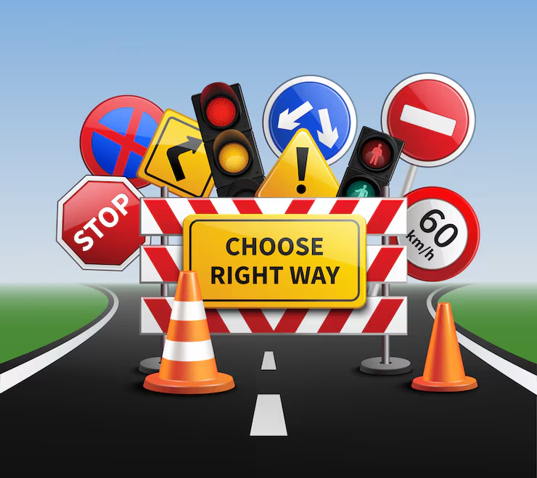

ROAD SAFETY AND TRAFFIC RULES
GAYATRI VIDYA PARISHAD COLLEGE OF ENGINEERING FOR WOMEN
ROLL NO: 325103210143.
CSE 3

Slide 2
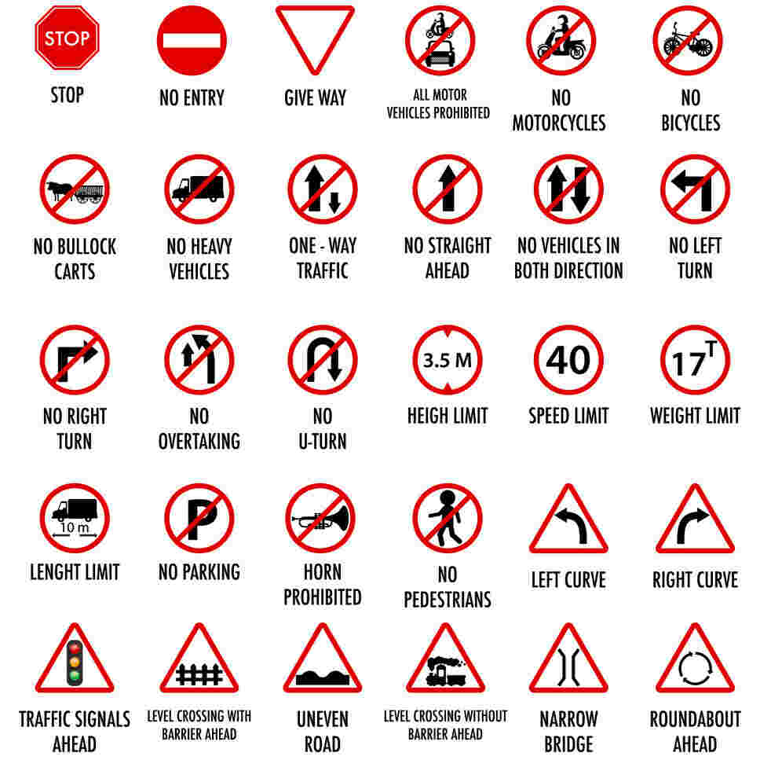
*WHAT SYMBOLS SAY?
MUST FOLLOW ALL THE TRAFFIC SYMBOLS PLACED ON THE ROAD SIDE.
FOLLOWING THESE TRAFFIC RULES REDUCE THE RISK OF ACCIDENTS.
TRAFFIC SYMBOLS HELPS IN ALL THE WAYS TO REDUCE ROAD ACCIDENTS CAUSED BY US AS WELL AS CAUSED BY OTHERS.

Slide 3
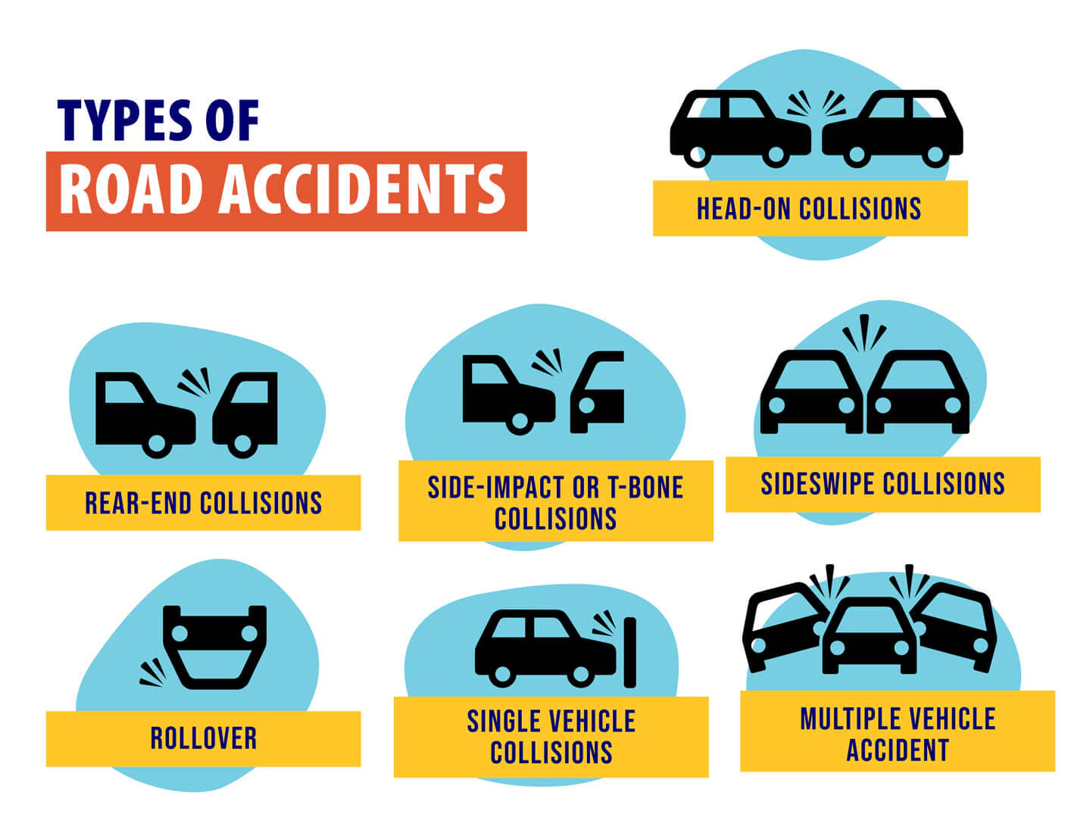
TYPES OF ROAD ACCIDENTS
THERE ARE 3 TYPES OF ACCIDENTS CAUSED ON ROADS:
. Rear-end collisions.
. Head-on collisions.
.T-bone accidents (side-impact).
.Side swipe collisions.
.Rollover.
.Single vehicle collisions.
.Multiple vehicle collisions.

Slide 4
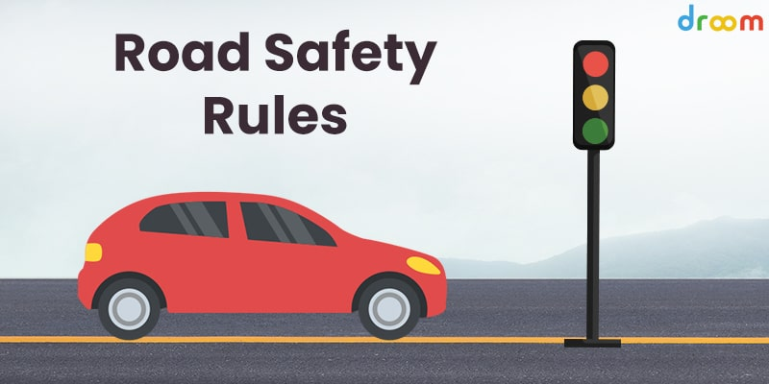

Slide 5
ROAD SAFETY MEASURES:
DON’T USE MOBILE WHILE DRIVING.
SHOULD NOT DRIVE FAST ON TRAFFIC ROADS.
DON’T AVOID TRAFFIC SIGNALS.
AVOID JOURNEY DURING NIGHT TIME.
MAINTAIN SPEED LIMIT.
DON’T DRINK AND DRIVE.

Slide 6
WHY ONE MUST FOLLOW TRAFFIC RULES?
Safety: Rules are designed to prevent collisions, injuries, and fatalities for drivers, passengers, and pedestrians.
For example, seat belts and helmets significantly reduce the risk of death in a crash.
Order and efficiency: Traffic rules manage the flow of vehicles, which prevents chaotic situations and reduces traffic jams.
Legal compliance: Following the law keeps you from incurring fines, penalties, or other legal trouble.
Fairness: They create a system where everyone knows what to expect from other road users, promoting a sense of fairness and predictability.
Protecting others: By following rules, you show respect for other road users and help protect them from your actions, especially in the event of an accident.

Slide 7
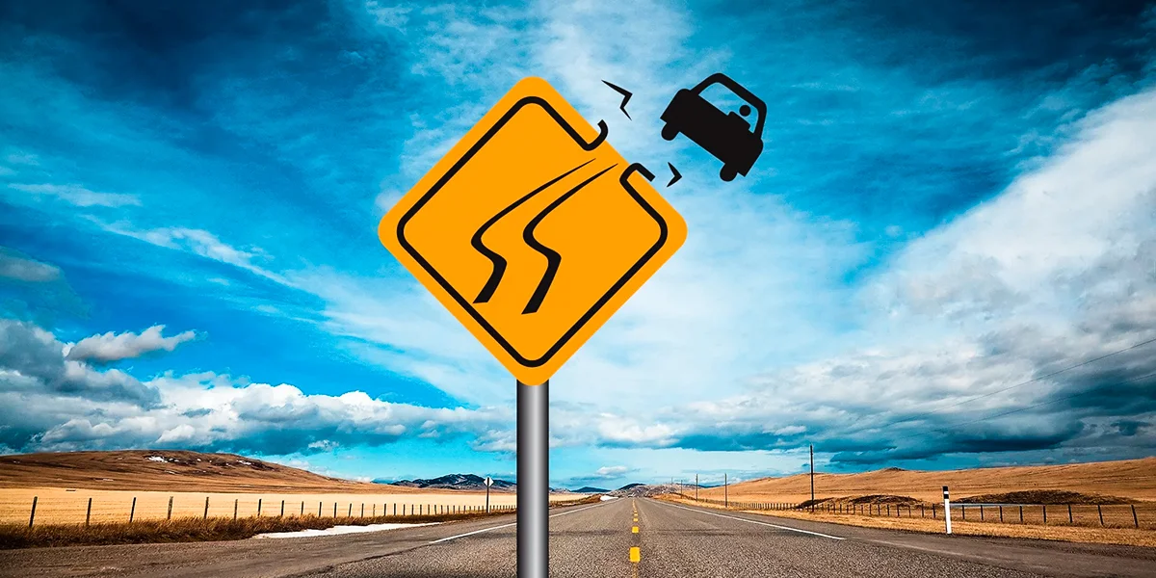
SMALL NOTICE TO WHO DRIVES FAST?
A small notice for fast drivers could be: "Slow down, you're risking lives. Your speed affects the time you have to react, and the outcome of a crash. Drive safely and follow the rules for a better and safer journey for everyone."

Slide 8
THANK YOU……..
BY
SWARNA (CSE-3)

